Slide 1
Random Picker
A quick random picker that lets you save and manage all your raffle groups!
[261025201] Sheera Ner-Gaon 209921550
Notes:
Be specific and direct in the title. Use the subtitle to give the specific context of the speech.
-The goal should be to capture the audience’s attention which can be done with a quote, a startling statistic, or fact. It is not necessary to include this attention getter on the slide.

Slide 2
The problem and the proposed solution
The Problem
Two major pain points exist:
decision-making: Users need a simple, impartial way to pick a winner.
Repetition: Frequent users (teachers, managers) waste too much time manually re-typing the same participant lists over and over. They lack secure group management.
The Solution: The Random Picker App
My app solves both issues with a strategic Freemium model:
Free: Instant, engaging Quick Raffle for one-off needs.
Premium: A subscription unlocks Group Management (powered by Firebase), eliminating repetitive entry and creating a vital utility for organizers.

Slide 3
Target Users
My app is designed for people who need to be impartial and efficient when dealing with groups. I see two main groups of users:
The Power User (The Subscriber): These are the true organizers, such as Teachers, Managers, and Coaches.
Main Goal: Their goal is to save time and maintain a fair, repeatable method for participant selection. They need to easily reuse their class lists, team rosters, or project groups.
Key Traits: They are generally organized, have medium-to-high tech proficiency, and value efficiency.
Usage Frequency: They will use the app daily or multiple times a week. For them, the ability to save groups via subscription is essential for their workflow.
The Quick User (The Free User): These are people with a spontaneous need, such as Friends, Family Organizers, and Social Event Hosts.
Main Goal: They want an instant, fun, and fair way to pick one name right now without creating an account or saving a list.
Usage Frequency: They use the app monthly or intermittently. They are drawn in by the free Quick Raffle feature and provide a strong base for future growth.

Slide 4
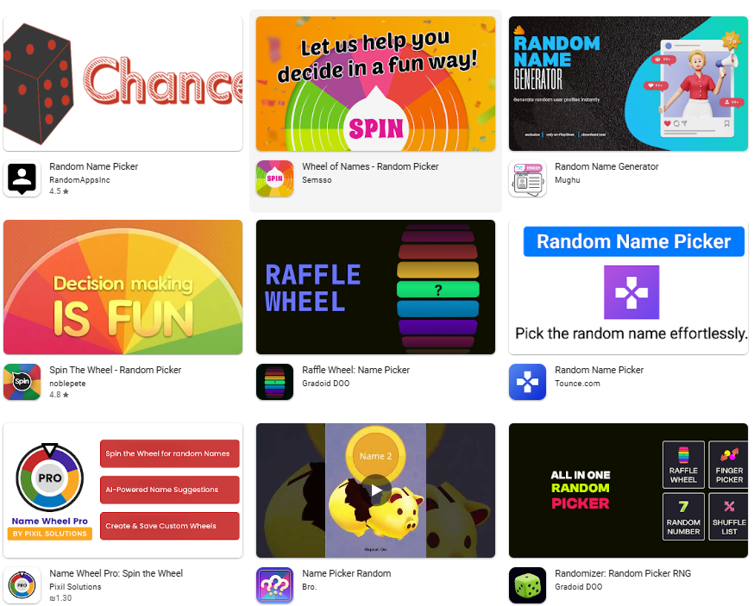
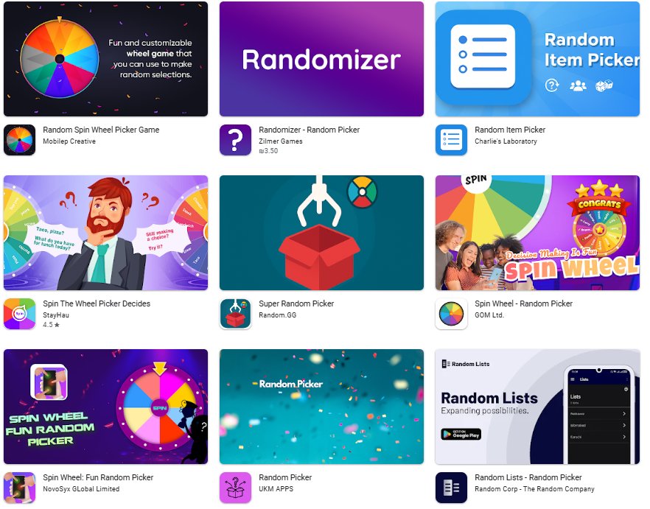
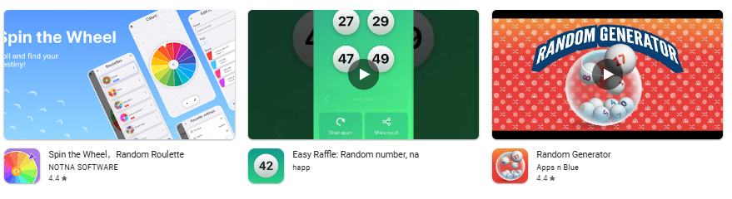
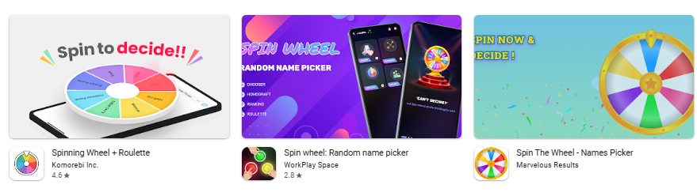
Market Research
Search keywords:
Random name
Random picker
Name raffle
Raffle wheel
Spin the wheel
Names draw
Best +1M downloads
Notes:
Use the background points to post details that are not common knowledge, or that the audience will need to understand the context of the speech.
-Do not read these main points from the PowerPoint, instead elaborate on these points during the speech.

Slide 5
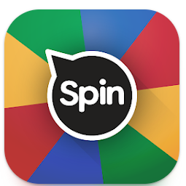
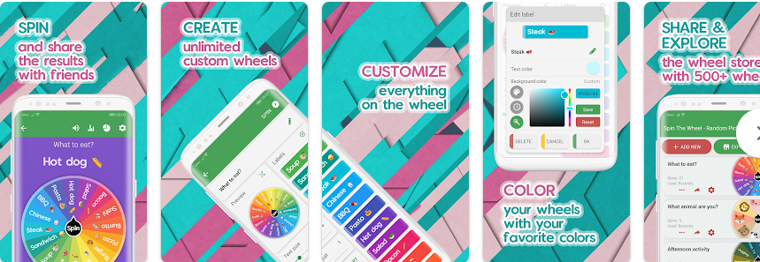
Market Research
Main features:
Unlimited wheels of fortune
Unlimited labels on every wheel
Customizable text and background of each label, choosing from dozens of colors
Easily share your wheels and spin results with friends
Spin The Wheel - Random Picker
Link
Released on Sep 16, 2018 Last Updated on Oct 10, 2025
Downloads: 10,000,000+ downloads
Rating 4.8 – 136k reviews
In-app purchases: ₪24.00 per item
Contains ads
Notes:
Use the background points to post details that are not common knowledge, or that the audience will need to understand the context of the speech.
-Do not read these main points from the PowerPoint, instead elaborate on these points during the speech.

Slide 6

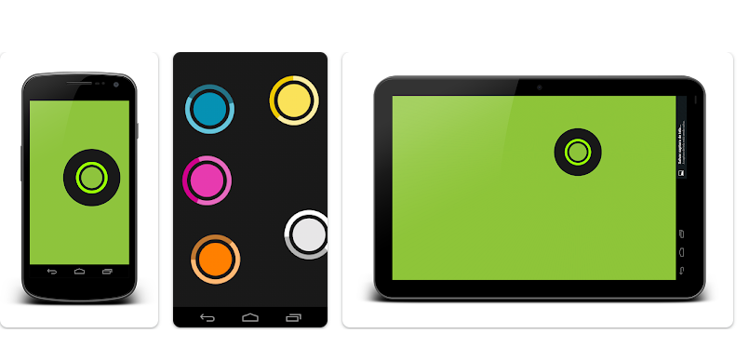
Market Research
Chwazi - Finger Chooser
Link
Released on Aug 2, 2013 Last Updated on Nov 6, 2025
Downloads: 1,000,000+ downloads
Rating 4.2 – 7.73k reviews
No In-app purchases
Does not contain ads
Main features:
Set up the number of fingers that you desire to choose
Place all your fingers on the screen and wait for the winner.
Notes:
Use the background points to post details that are not common knowledge, or that the audience will need to understand the context of the speech.
-Do not read these main points from the PowerPoint, instead elaborate on these points during the speech.

Slide 7

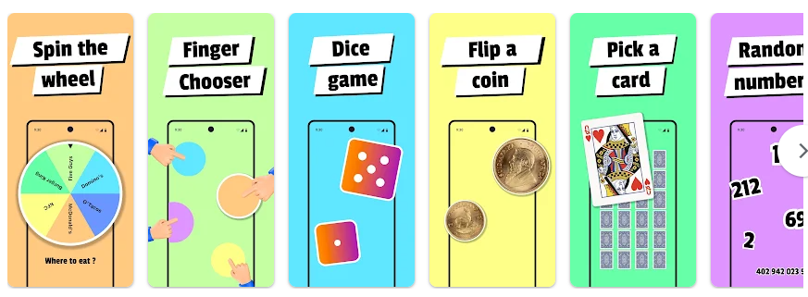
Market Research
Main features:
Wheel spinner, Finger Chooser, Coin Flip and even more modes to help you make tiny decisions fast
Choose from different themes for each mode.
Customize your content with predefined lists or personal entries.
Choose - Chooser game
Link
Released on Jul 30, 2025 Last Updated on Aug 3, 2025
Downloads: 1k+ downloads
No ratings or reviews
In-App Purchases
Does not contain ads
Notes:
Use the background points to post details that are not common knowledge, or that the audience will need to understand the context of the speech.
-Do not read these main points from the PowerPoint, instead elaborate on these points during the speech.

Slide 8
My App - list of features
Free Features
Quick Random Selection
Fun Winner Animation
Ad-Supported Access
Secure User Login
Premium Features
Cloud Group Management
Persistent Member Lists
Firebase Data Backup
Ad-Free Experience
Notes:
Use the background points to post details that are not common knowledge, or that the audience will need to understand the context of the speech.
-Do not read these main points from the PowerPoint, instead elaborate on these points during the speech.

Slide 9
Feature comparison table
Feature | My App (Random Picker) | Choose (App) | Spin The Wheel | Chwazi | Pen & Paper
Input Method | Text & Saved Groups | Multi-Mode (Wheel, Cards) | Text & Lists | Fingers Only (Physical) | Handwriting
Remote Friendly | Yes (Cloud lists) | No (Local) | No (Local) | No (Must touch screen) | No
Cloud Backup | Yes (Firebase) | No (Local) | No (Local) | No | No
Free Version | 1 Saved Group + Ads | Locked Features + Ads | Unlimited + Ads | Unlimited + Ads | Unlimited
Ad-Free Option | Subscription | Subscription | One-time | One-time | Always Free
Notes:
Use the background points to post details that are not common knowledge, or that the audience will need to understand the context of the speech.
-Do not read these main points from the PowerPoint, instead elaborate on these points during the speech.

Slide 10
SWOT Analysis
Strengths
Cloud Persistence: Unlike many competitors, groups are saved to the cloud (Firebase) and accessible from any device.
User Trust: The app uses a secure Google/Email login (Firebase Auth), ensuring only the user can access their private lists.
Fairness: The algorithm ensures purely random, unbiased selection, solving the problem of "indecision“.
Simplicity: The interface is focused purely on utility without clutter or confusing modes.
Weaknesses
Internet Dependency: Because it relies on Firebase for saving/loading groups, the premium features require an active internet connection.
Feature Variety: The app currently offers only list-based raffles, whereas competitors like "Choose" offer dice, coins, and wheels.
Subscription Barrier: Users must pay to save more than one group, which might turn away casual users who want everything for free.
Opportunities
Remote Teams & Classrooms: There is a growing need for tools that work across devices for teachers and remote managers.
Feature Expansion: You can easily add new modes (coin flip, dice) in future updates to match competitor features.
B2B Licensing: Schools or companies might pay for a bulk license to ensure their data is secure and ad-free.
Threats
Crowded Market: There are thousands of free "random picker" apps on the store, making discoverability difficult. No-Login
Competitors: Users might prefer apps that don't require a login, even if they are less secure.
Data Privacy Concerns: Users are becoming more hesitant to share personal data (email) with simple utility apps.

Slide 11
In App Purchases
One-time purchase:
Ads appear in the free version - by paying a one-time payment of 10$ the ads will disappear.
Subscription:
In the free version there is a limit of 1 saved group - subscribers have no limit.
No more ads.

Slide 12
Beta / Soft Launch
Target Beta Group
Who: 10 Friends & Family Members.
Why: They are easy to recruit, forgiving of bugs, and can give honest feedback in a relaxed setting.
The "Pizza Night" Test
Scenario: We will host a game night or dinner where we must use the app to make every decision (e.g., "Who pays for pizza?", "Which movie to watch?", "Who goes first in the game?").
Goal: To see if the app is actually fun to use in a social setting and if the animation builds excitement.
What We Will Test
Usability: Can my parents/friends add names and run a raffle without asking for help?.
Stability: Does the app crash when we pass the phone around?.
Feedback
Method: Casual conversation. I will ask, "Was that confusing?" or "Did the animation feel too long?" right in the moment.

Slide 13
Permissions Required
None!
My app respects user privacy and does not ask for Camera, Location, Microphone, or Storage access.

Slide 14
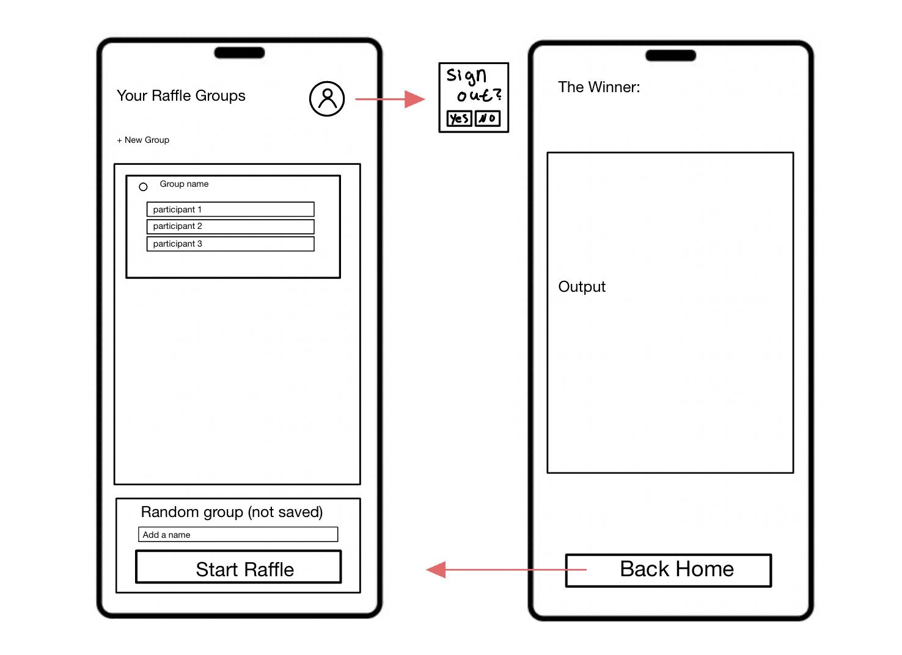
UX - Wireframes

Slide 15
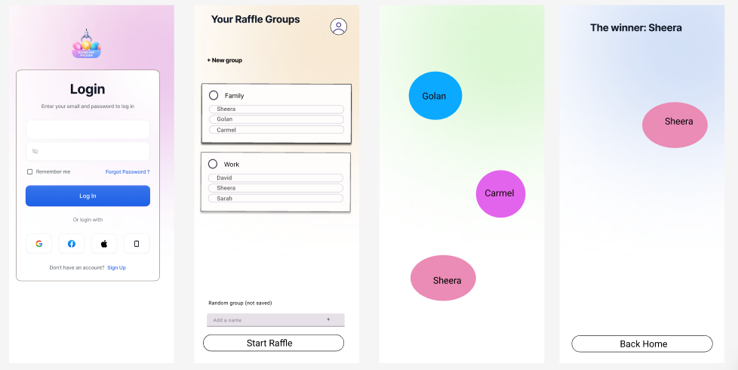
UI - Mockup

Slide 16

Server
use that will be made on the server:
Backup files for subscribed users in firebase Real-time Database.
Expected costs in the future:
Because the data that comes up as a backup is very small, and because it is only available to subscribers, high costs are not expected - if there are any

Slide 17
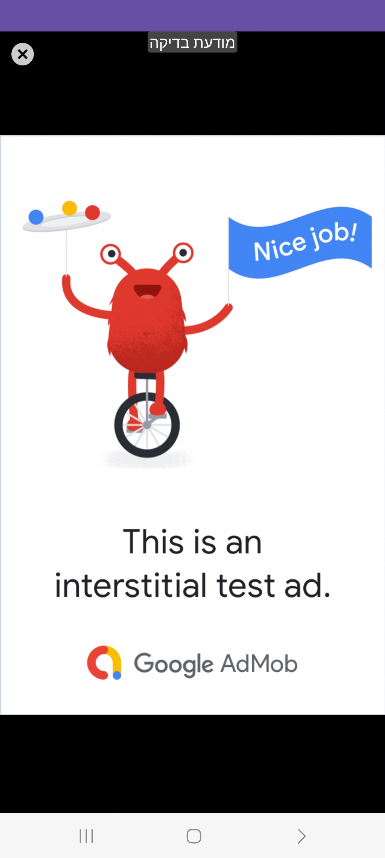
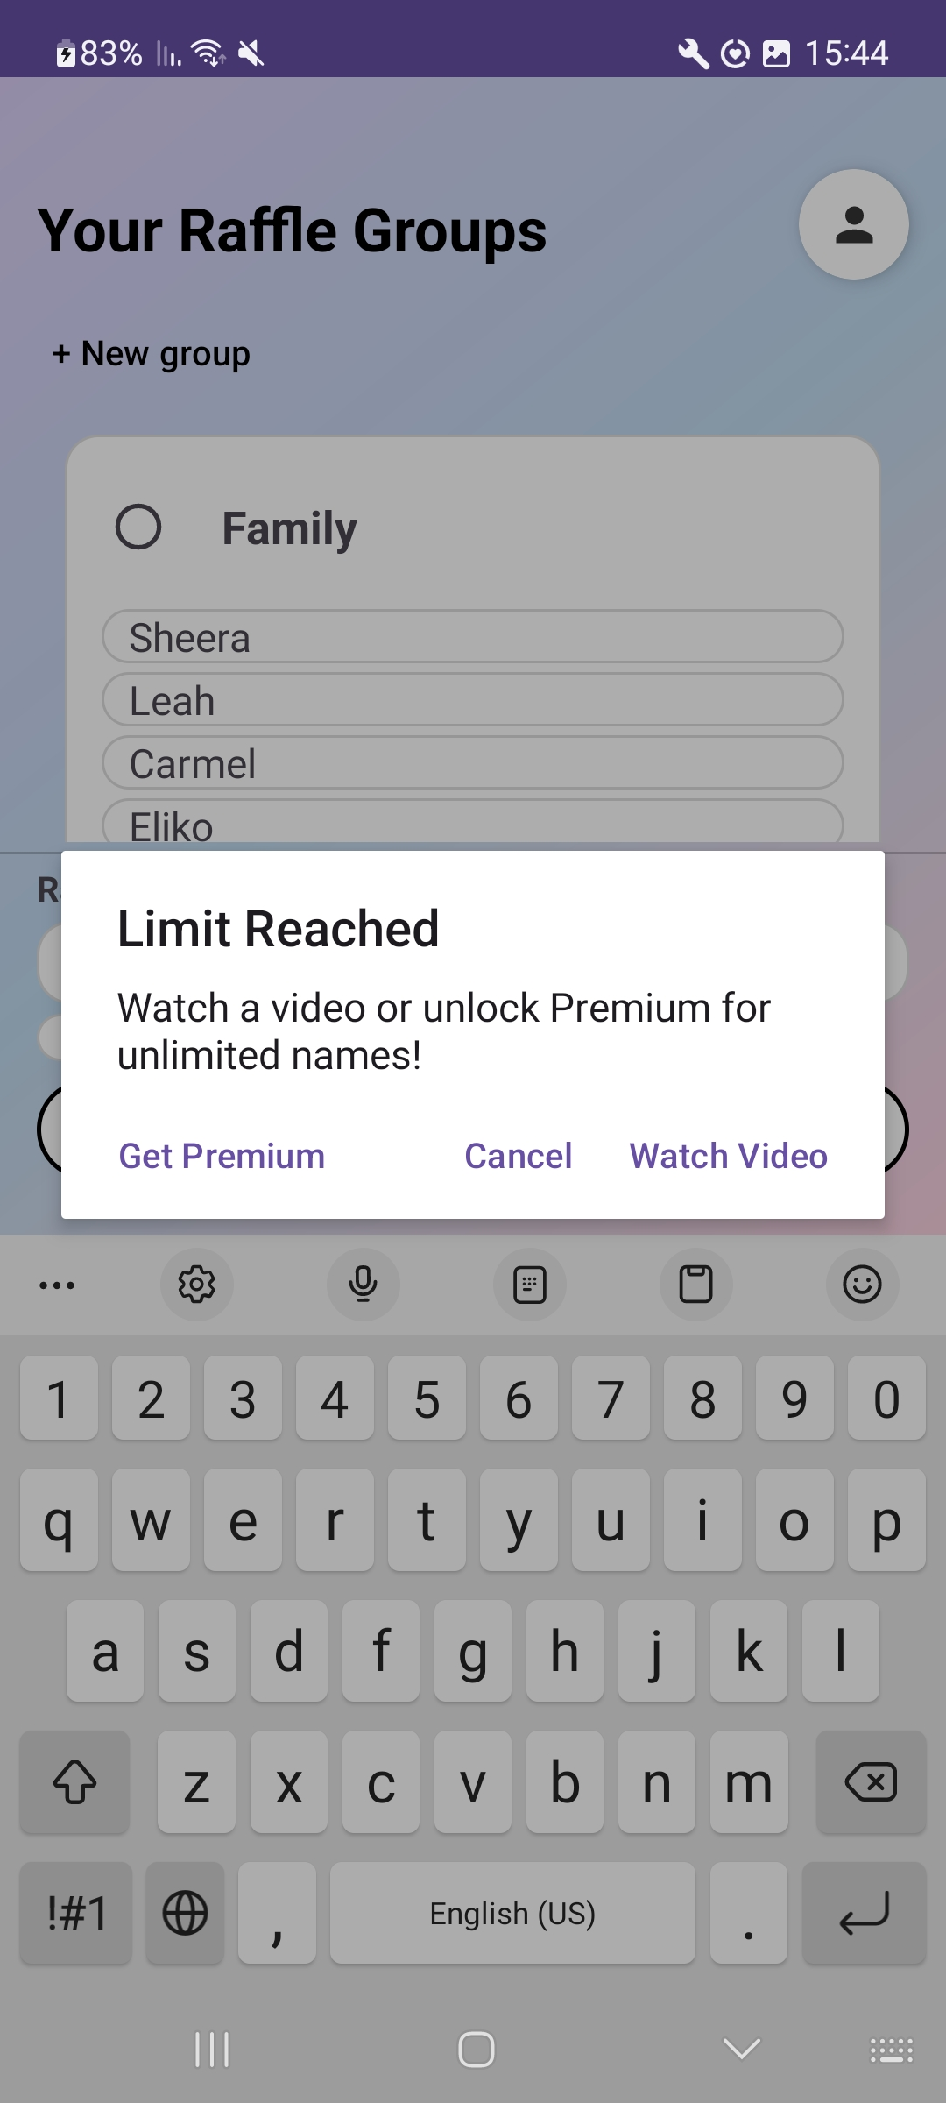
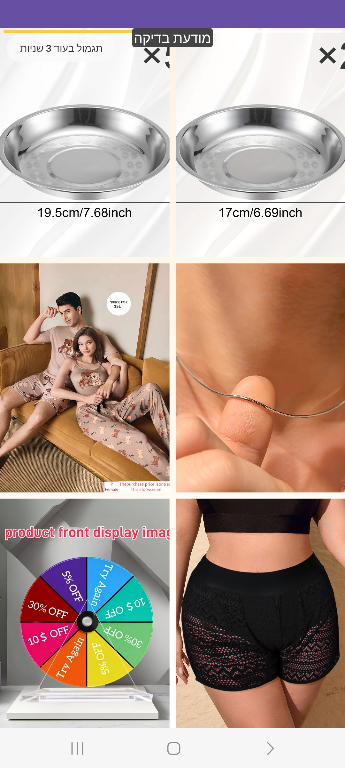
Advertisements
Interstitial- Full-screen ads that cover the interface of an app until closed by the user
Rewarded - Ads that reward users for watching short videos and interacting with playable ads and surveys

Slide 18
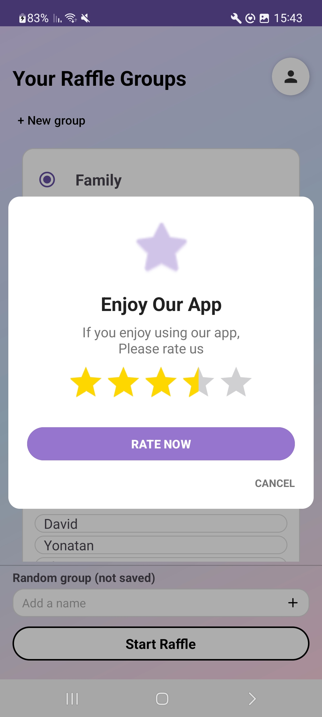
Rate App
Rate pop – up after a few raffles

Slide 19
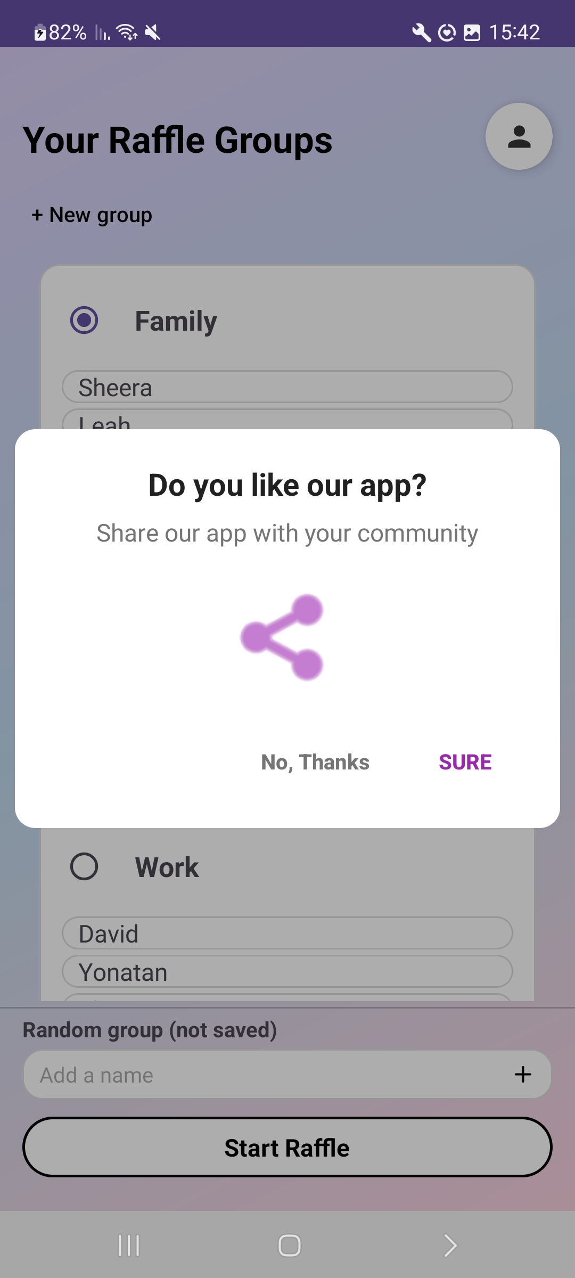
Share App
Share apps on multiple platforms like social media, email, WhatsApp, etc.

Slide 20
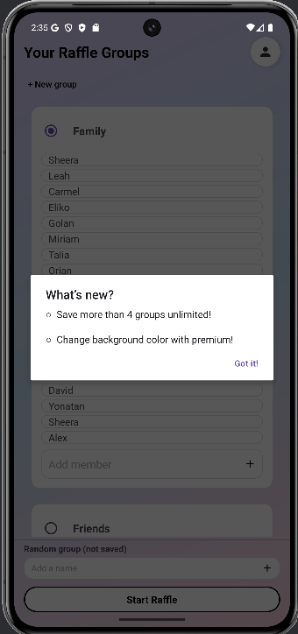
New Version Popup
What’s new?
Save more than 4 groups unlimited!
Change background color with premium!

Slide 21
Data Security
What permissions does the app require?
Internet Access: This is the only permission used. It is required to sync groups with the Firebase Database and to load advertisements via AdMob.
No Dangerous Permissions: The app intentionally avoids accessing private data. We do not use the Camera, Location, Contacts, or Microphone.

Slide 22
Bureaucratic Documents
Privacy policy
Link
TOF (Terms of use)
Link
GDPR?
Link

Slide 23
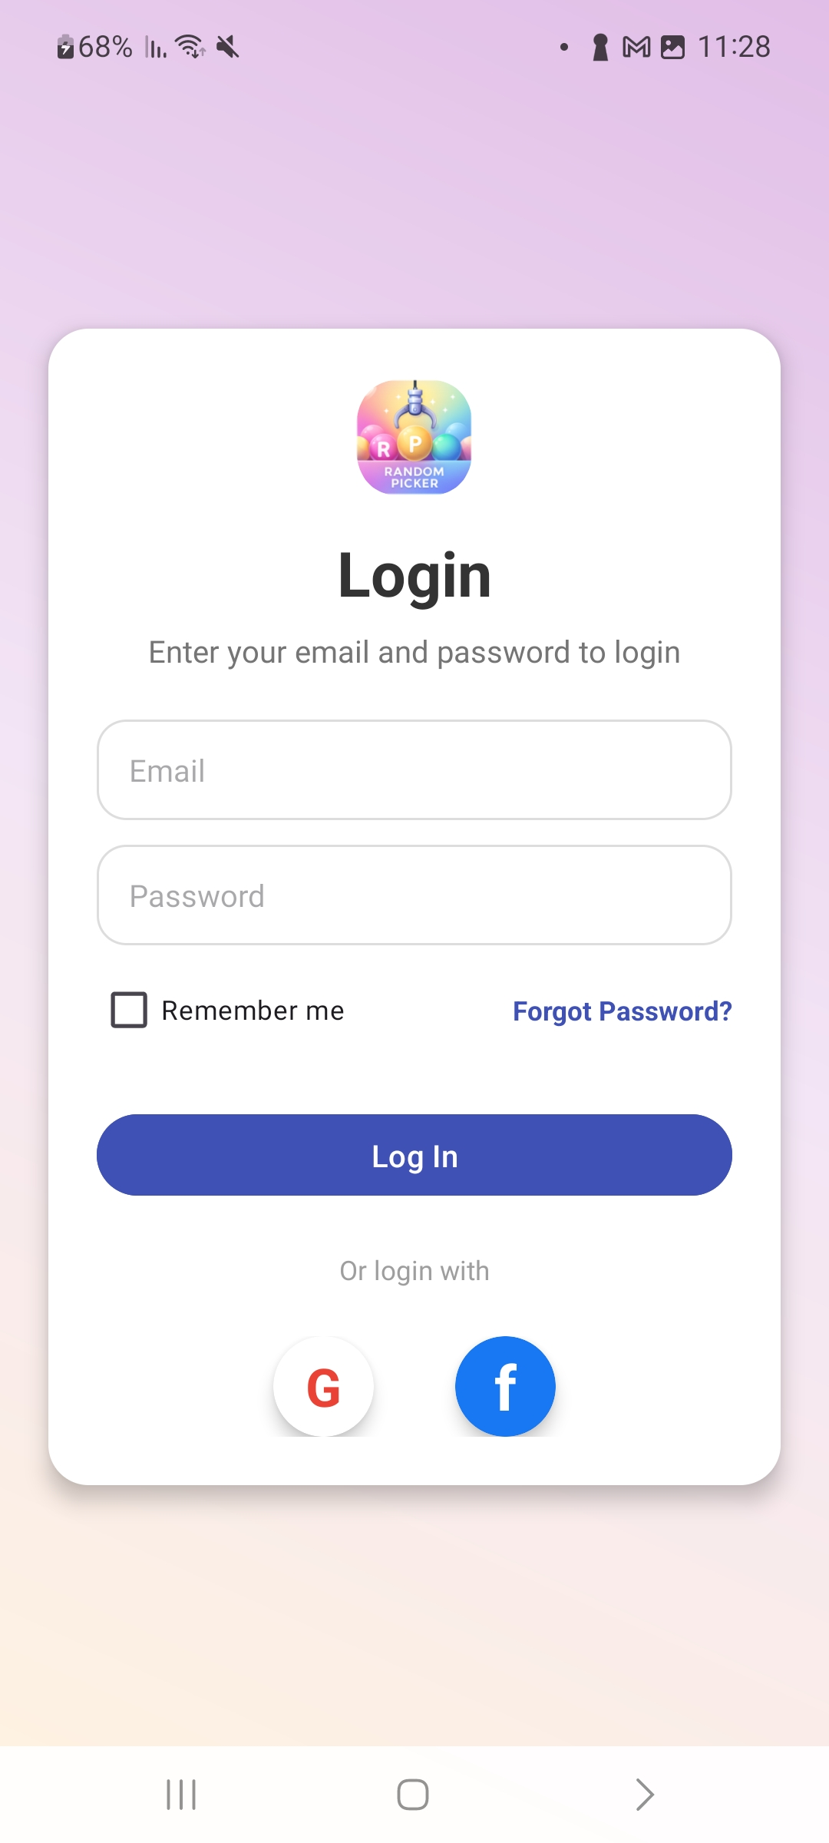
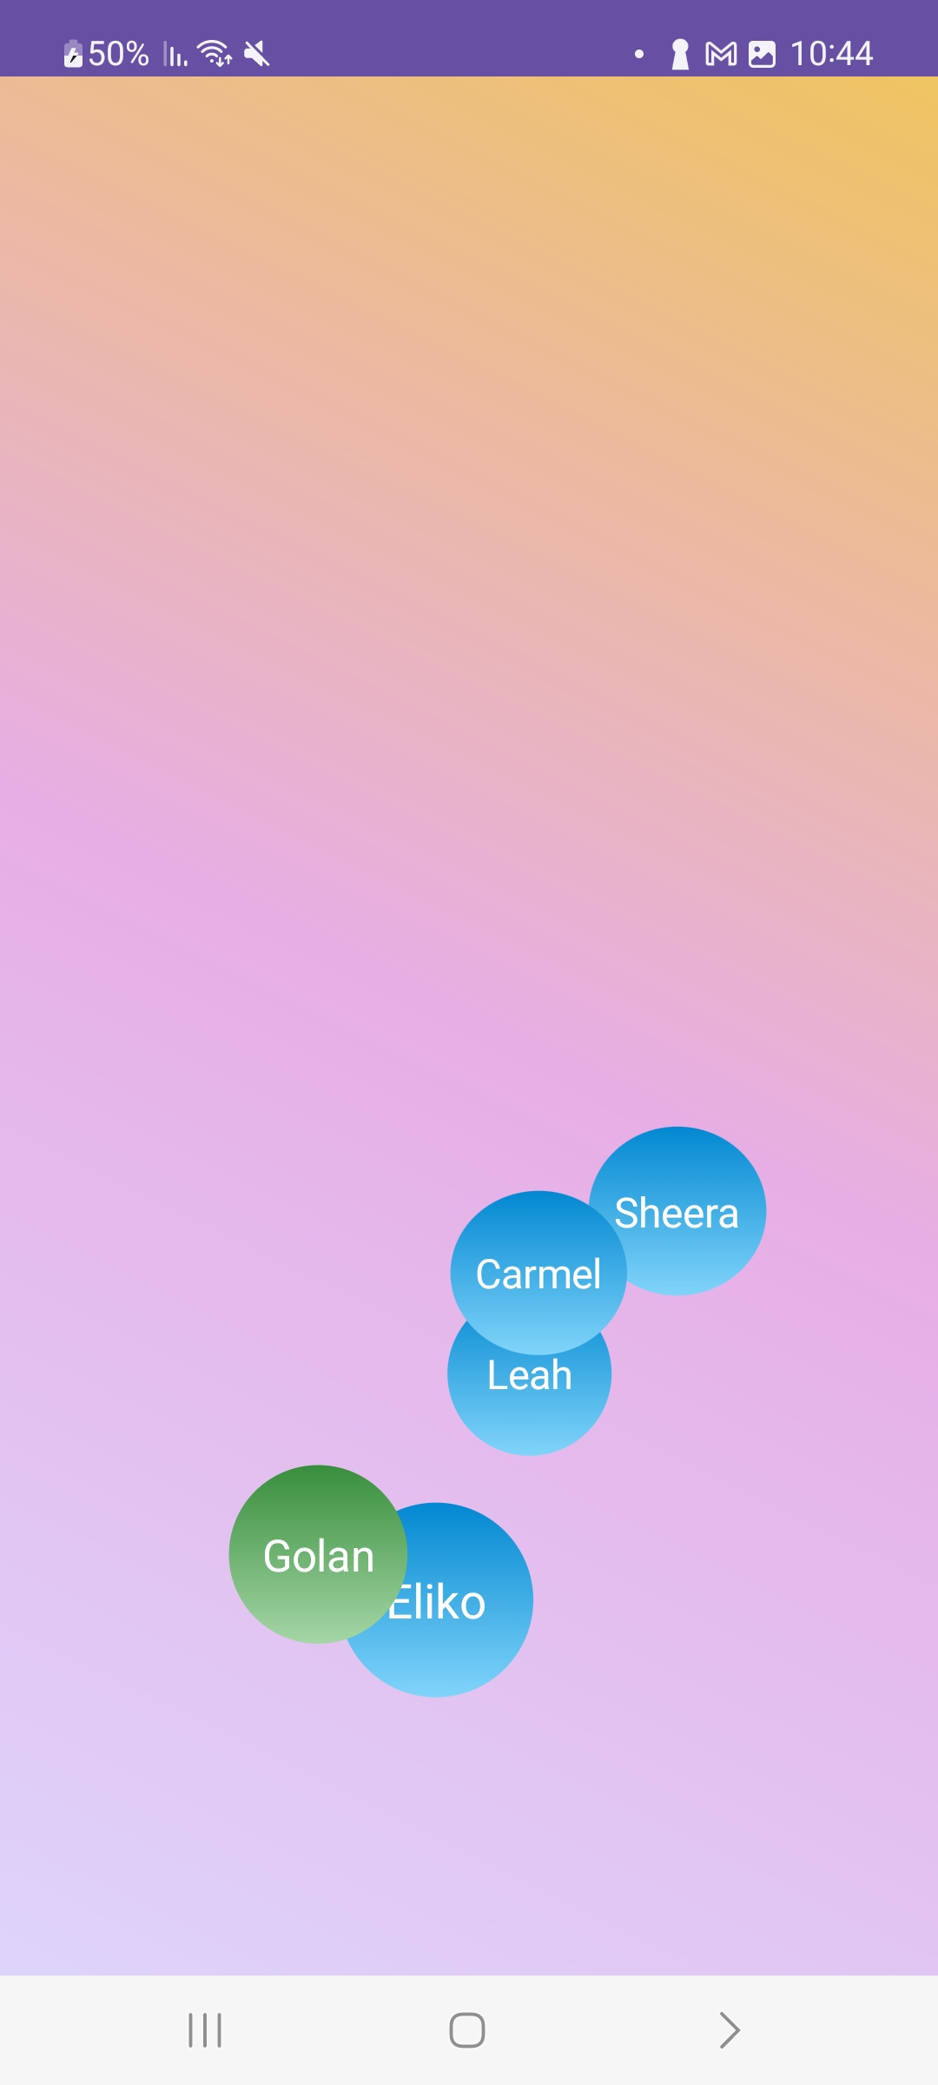
Screenshots & Video

